Slide 1
Naming Convention
1. Literal values
https://dev.mysql.com/doc/refman/8.0/en/literals.html

Slide 2
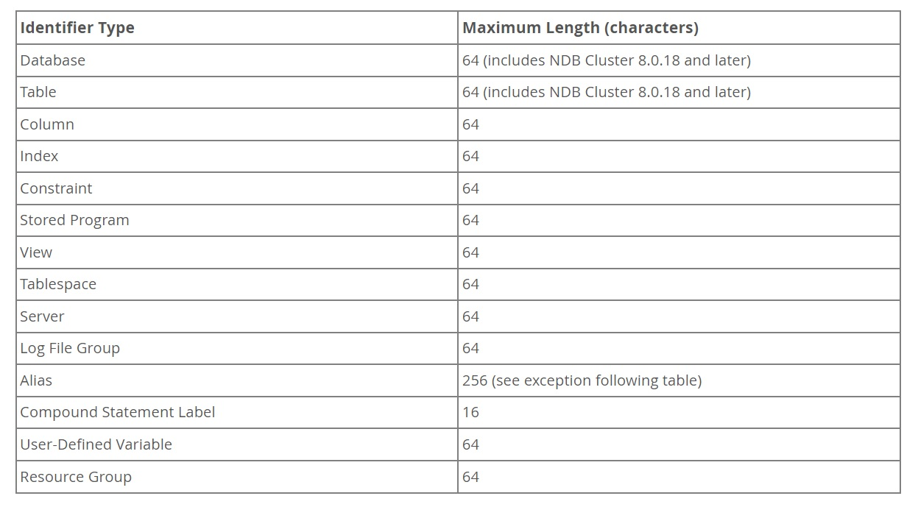
Naming Convention
2. Schema object names
Length limits: https://dev.mysql.com/doc/refman/8.0/en/identifier-length.html

Slide 3
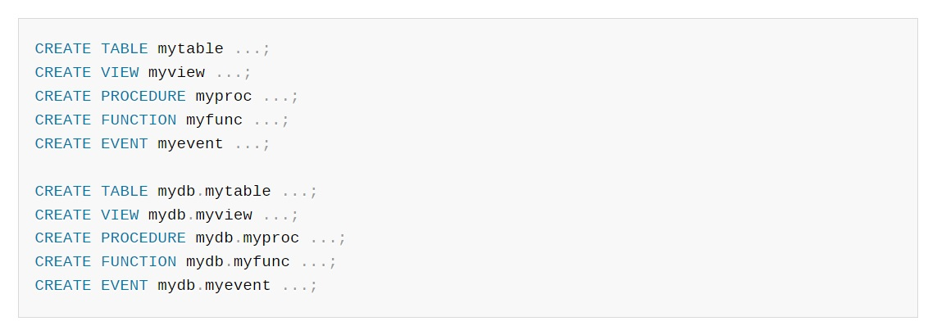
Naming Convention
2. Schema object names
Qualifiers: https://dev.mysql.com/doc/refman/8.0/en/identifier-qualifiers.html

Slide 4
Naming Convention
2. Schema object names
Case sensitivity: https://dev.mysql.com/doc/refman/8.0/en/identifier-case-sensitivity.html
Almost used with UNIX, not case sensitive with Windows or MacOS

Slide 5
Naming Convention
2. Schema object names
Mapping identifiers to file names : https://dev.mysql.com/doc/refman/8.0/en/identifier-mapping.html

Slide 6
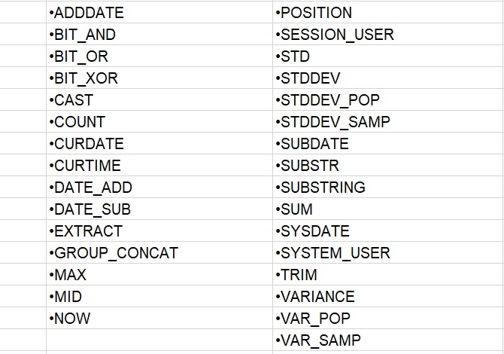
Naming Convention
2. Schema object names
Function name parsing and Resolution : https://dev.mysql.com/doc/refman/8.0/en/function-resolution.html
Some function name require space when parsing

Slide 7
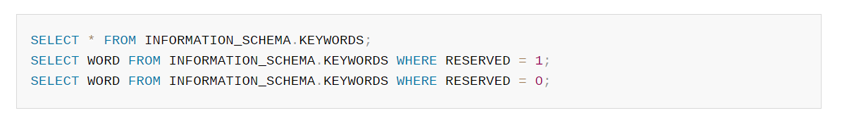
Naming Convention
3. Keywords and Reserved words
Certain keywords : SELECT, DELETE, BIGINT,… and built-in function names are reserved words and require special treatment for use as identifiers.
Reserved keywords are permitted only with ` ` when non-reserved keywords are not.
Query to extract keyword list in MySQL:
https://dev.mysql.com/doc/refman/8.0/en/keywords.html

Slide 8
Naming Convention
4. User defined variables
Syntax : @var_name, where var_name consists of alphanumeric character, ., _, and $. Can contain other characters if put as string or identifiers (e.g: @’my-var’)
https://dev.mysql.com/doc/refman/8.0/en/user-variables.html

Slide 9
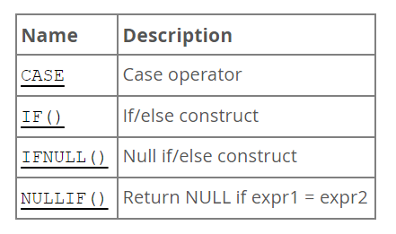
Flow Control Functions
There are some main flow control operators in MySQL

Slide 10
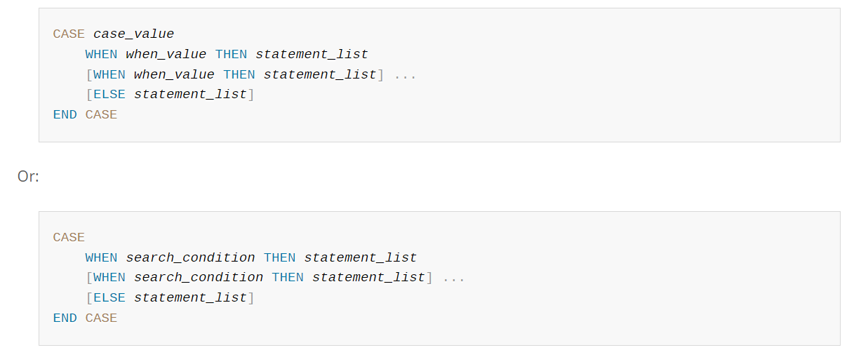
Flow Control Functions Syntax
CASE statement

Slide 11
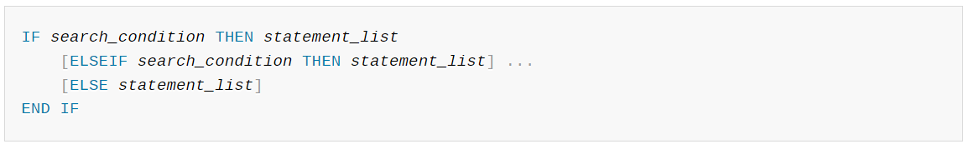
Flow Control Functions Syntax
2. IF statement

Slide 12
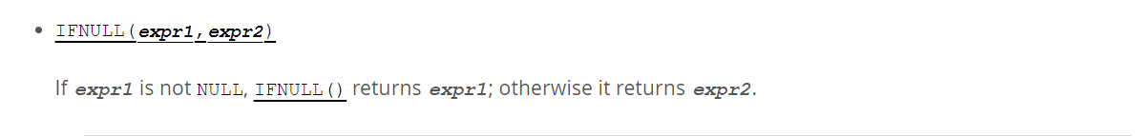
Flow Control Functions Syntax
3. IFNULL statement

Slide 13
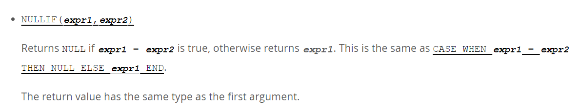
Flow Control Functions Syntax
4. NULLIF statement

Slide 14
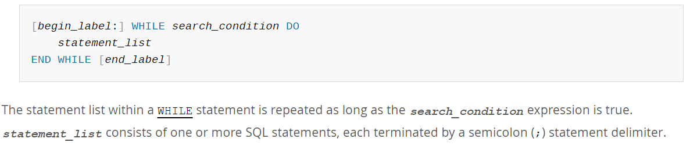
Flow Control Functions Syntax
5. WHILE statement

Slide 15
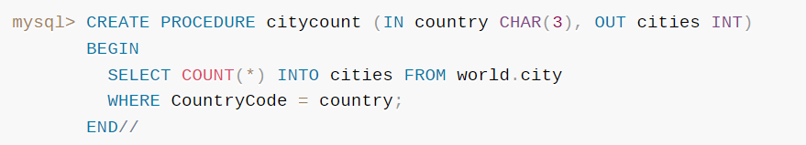
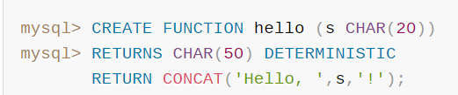
Stored Routine
A set of SQL statements that can be stored in the server. Once this has been done, clients don’t need to keep reissuing the individual statements but can refer to the stored instead.
There are two main stored routine types in MySQL: stored procedure and stored function
Stored Procedure | Stored Function

Slide 16
Stored Routine
Benefits :
When multiple client applications are written in different languages or work on different platforms, but need to perform the same database operations.
When security is paramount. E.g : Banks, use stored procedures and functions for all common operations, such as credit card transaction, payment transfer, ….. This provides a consistent and secure environment.

Slide 17
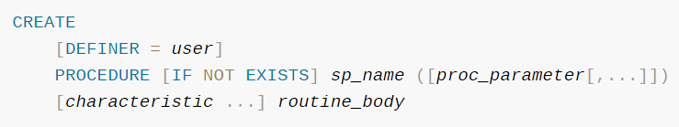
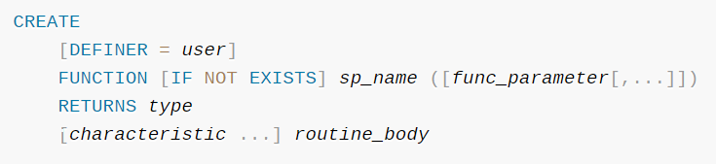
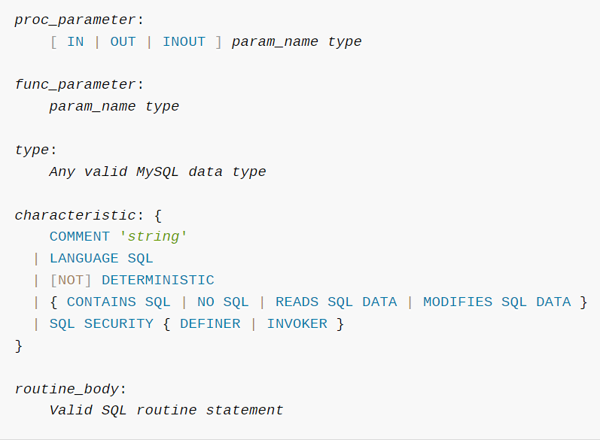
Stored Routine Syntax
Stored Procedure
Stored Function

Slide 18
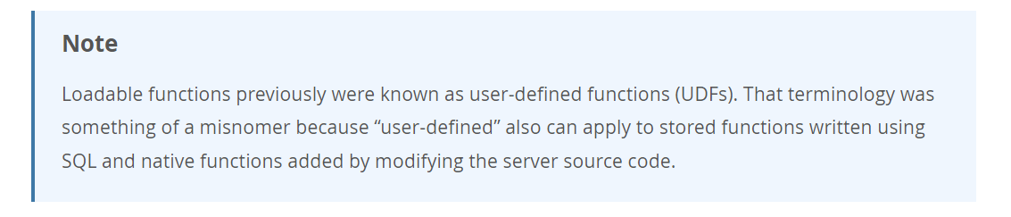
Adding Function to MySQL
There are 3 ways to add a new function to MySQL:
Create a stored function
Create a native (built-in) MySQL function
Use the loadable function interface

Slide 19
Stored Procedure vs Stored Function
Supports in, out and in-out parameters (input & output parameters)
Can call functions as needed
No provision to call procedures from select/having and where statements
Transactions can be used
Can do exception handling by inserting try/catch blocks
Need not return any value
All the database operations like insert, update, delete can be performed
Can return multiple values
Support only input parameters, no output parameters
Can not call a stored procedure
Can call from a select statement
No transactions are allowed
No provision for explicit exception handling
Must return a result or value to the caller
Only select is allowed
Typically returns only one value

Slide 20
Trigger
A named database object associated with a table, and that activates when a particular event occurs for the table.
Some uses:
Perform checks of values to be inserted into a table
Perform calculations on values involved in an update
Trigger events: insert, update and delete operations on rows in the associated table

Slide 21
Trigger Benefits
Triggers help us to enforce business rules.
Triggers help us to validate data even before they are inserted or updated.
Triggers help us to keep a log of records like maintaining audit trails in tables.
SQL triggers provide an alternative way to check the integrity of data.
Triggers provide an alternative way to run the scheduled task.
Triggers increases the performance of SQL queries because it does not need to compile each time the query is executed.
Triggers reduce the client-side code that saves time and effort.
Triggers help us to scale our application across different platforms.
Triggers are easy to maintain.

Slide 22
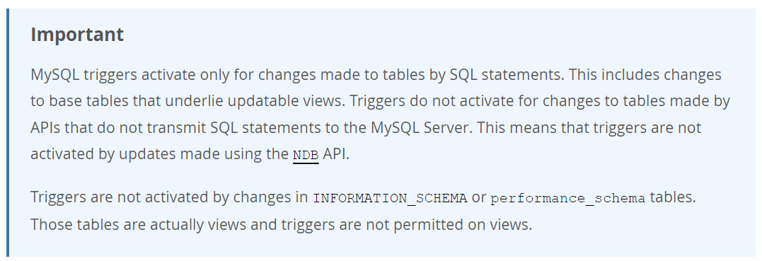
Trigger

Slide 23
Trigger Limits
Can not create triggers on view
Can not use transaction on trigger
Can not use RETURN statement on trigger
Using trigger will affect the memory used for SELECT statements
All triggers in the database can not be duplicated

Slide 24
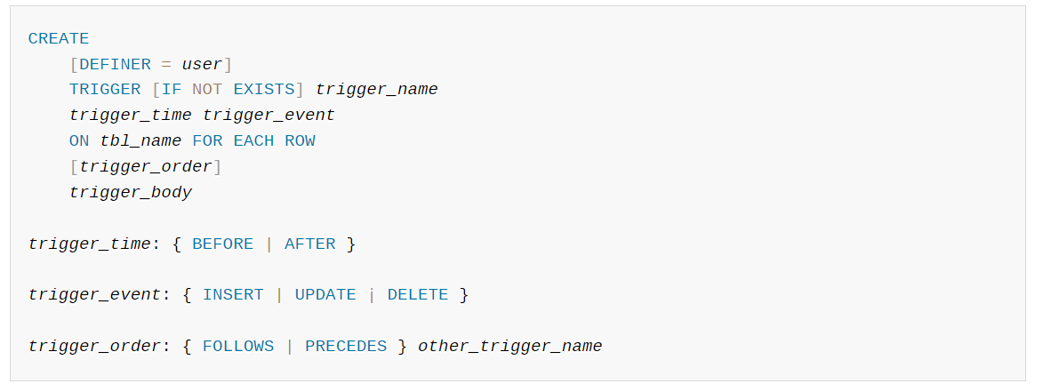
Trigger
Syntax

Slide 25
Trigger vs Stored Procedure
Trigger
Stored Procedure
Can not be called manually
Executes automatically when event happens and can be used for reporting and data protection
Can not be called from client application
Can be called manually
Has to be called by someone
Can be called from client application

Slide 26
Transaction
Atomic units of work that can be committed or rolled back. When a transaction makes multiple changes to the database, either all the changes succeed when the transaction is committed, or all the changes are undone when the transaction is rolled back.
Database transaction have 4 properties (ACID):
Atomicity: “all or nothing”, guarantee that either all of the transaction succeeds or none of it does.
Consistency: guarantee that all data will be consistent. All data will be valid according to all defined rules, including any constraints, cascades, and triggers that have been applied on the database.
Isolation: guarantee that all transactions will occur in isolation. No transaction will be affected by any other transaction.
Durability: once a transaction is committed, it will remain in the system – even if there’s a system crash immediately following the transaction.

